Slide 1
MRA Project 1
Vikram Reddy
DSBA_January,2023

Slide 2
EXECUTIVE SUMMARY
Automobile parts manufacturing company has data with respect to customers from different countries. The data contains various attributes Quantity ordered, unit price, total sales, type of product, transaction orders done by the customer.
The data should be understand, cleaned and visualized.
Sales data to be visualized and can be analyzed for a Trend.
RFM analysis to be performed for segmentation of customers
Valuable insights and inferences to be produced

Slide 3
AGENDA
Perform customer segmentation by using RFM analysis.
Derive valuable Insights from data & RFM analysis

Slide 4
PROBLEM STATEMENT
The data contains numerical & categorical data about customer buying automobile parts from a company.
Understanding customer data by plotting distribution plots.
Performing RFM Analysis so that customers can be segmented for better understanding & Targeting customers for Increasing sales.

Slide 5
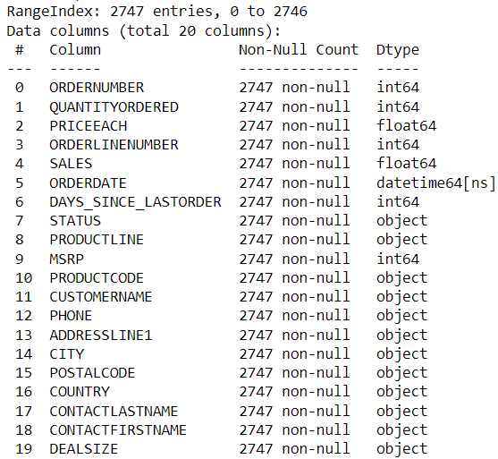
Understanding the Data
There are 2747 rows and 20 columns
No Null values were Observed.
No duplicates were found.

Slide 6
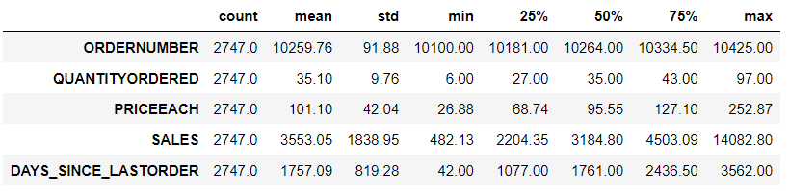
Understanding the Data
Quantity ordered ranges from 6 to 97.
Sales ranges from 3550 to 14080.
Recency ranges from 42 to 3562.
All data is found to be in order by understanding.

Slide 7
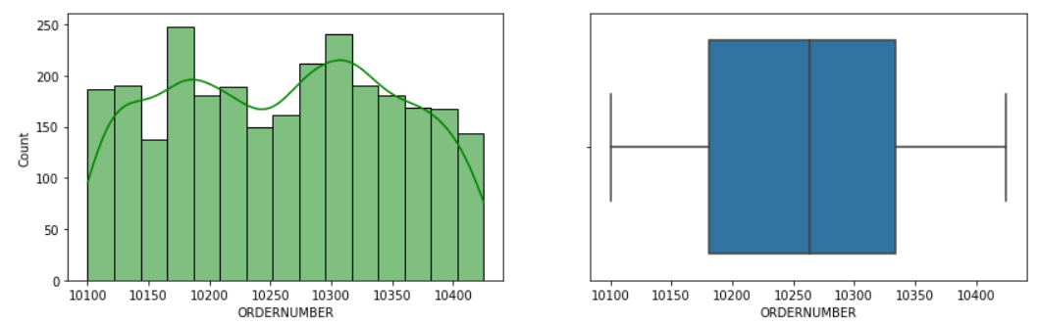
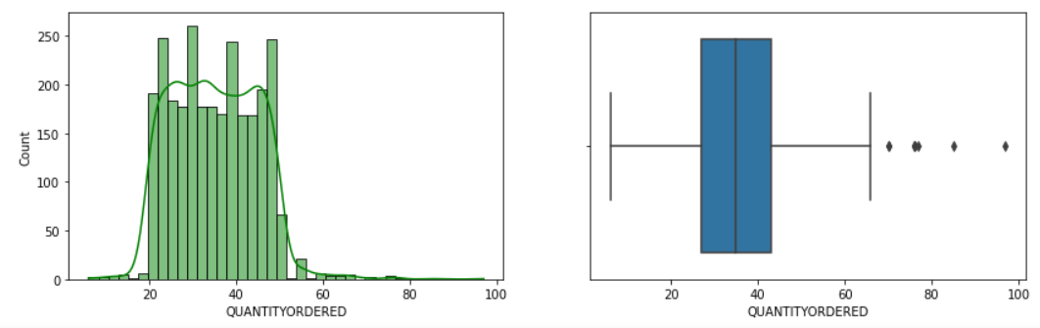
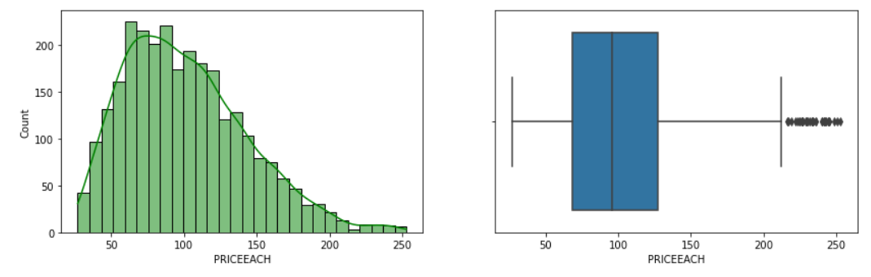
Univariate Analysis
Understanding the Data
Observations
Order number which is frequency found to rectangular distribution.
Quantity is also rectangular distribution.
Unit price is found to close to Normal distribution

Slide 8
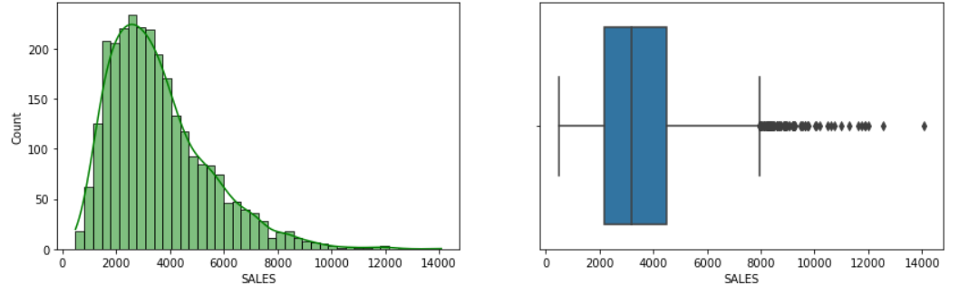
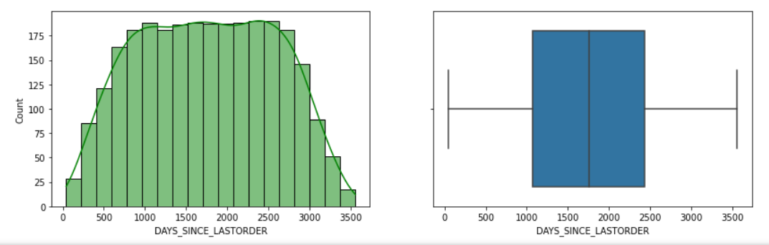
Univariate Analysis
Understanding the Data
Observations
Sales is right skewed and Not Normally distributed.
Recency is rectangular distribution.

Slide 9
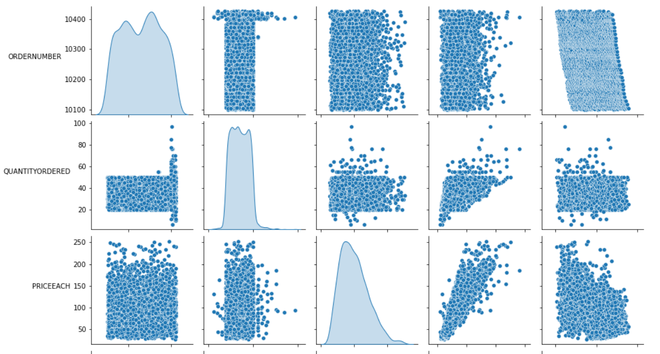
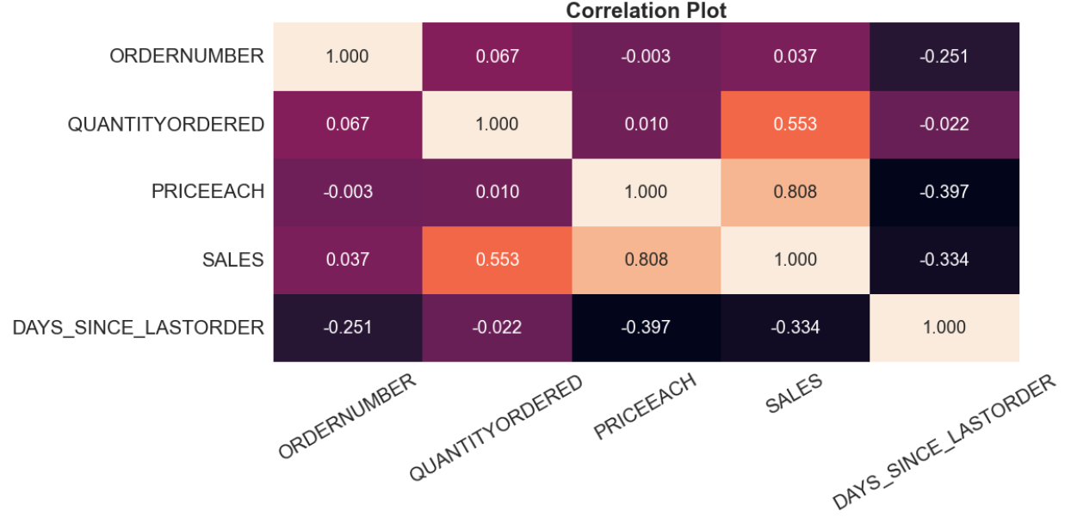
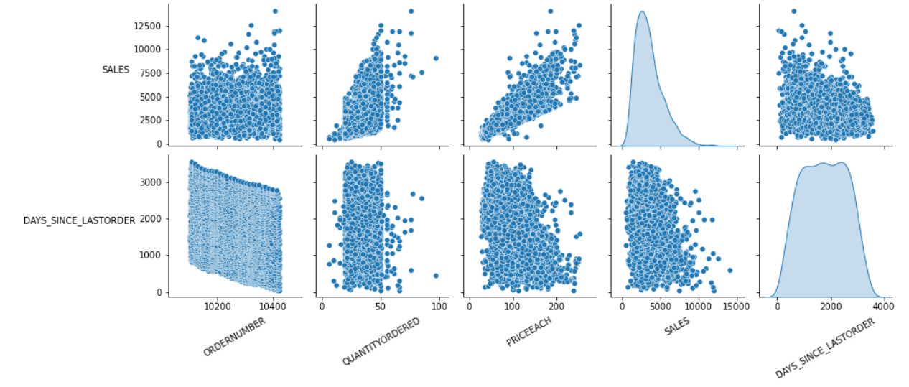
Bivariate Analysis
Understanding the Data
Observations
Last order has negative correlation with others
Quantity, price & sales are correlated to each other.

Slide 10
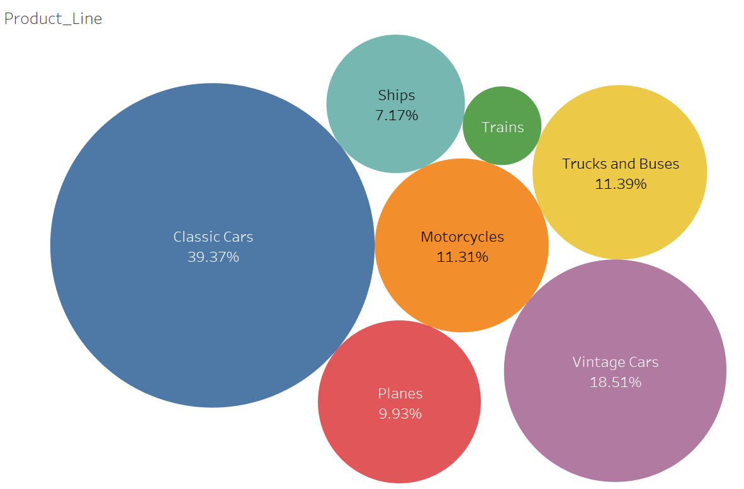
Sales across categories
Understanding the Data
Observations
Classic Cars occupy 40% of total sales.
Vintage cars about 18% of total sales.
Motorcycles, Trucks/Bus & Planes around 10%

Slide 11
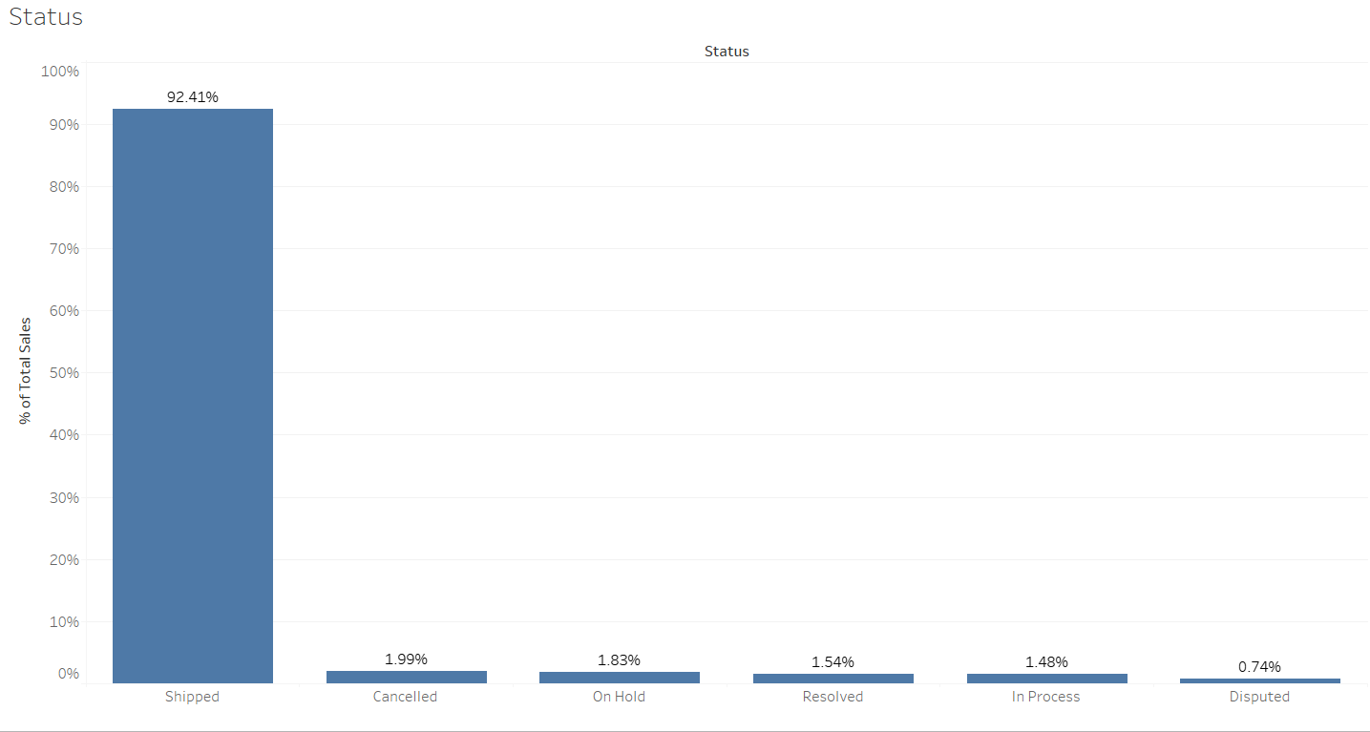
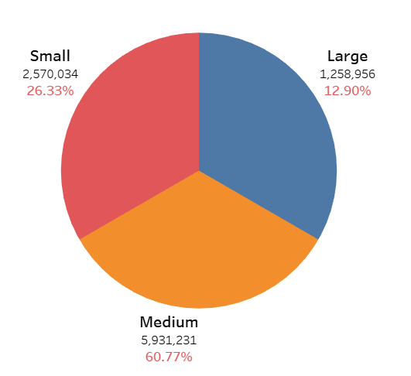
Sales across categories
Understanding the Data
Deal Size
Observations
Medium size grabs 60% of market sales.
Shipped goods contribute most of the sales more than 90%.

Slide 12
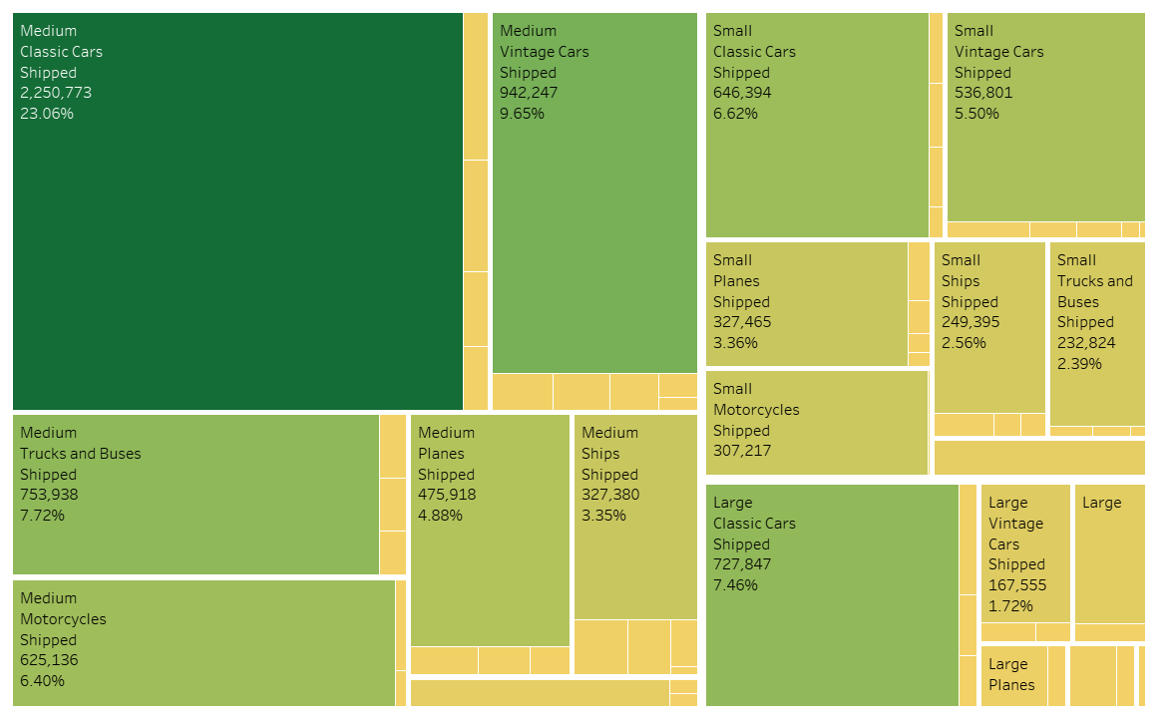
Sales across categories
Understanding the Data
Observations
Shipped, Medium size Classic cars, Vintage cars, motorcycles & Trucks/Bus grab 47% of markets sales.
Shipped, Large size, classic cars about 7.5% of market sales

Slide 13
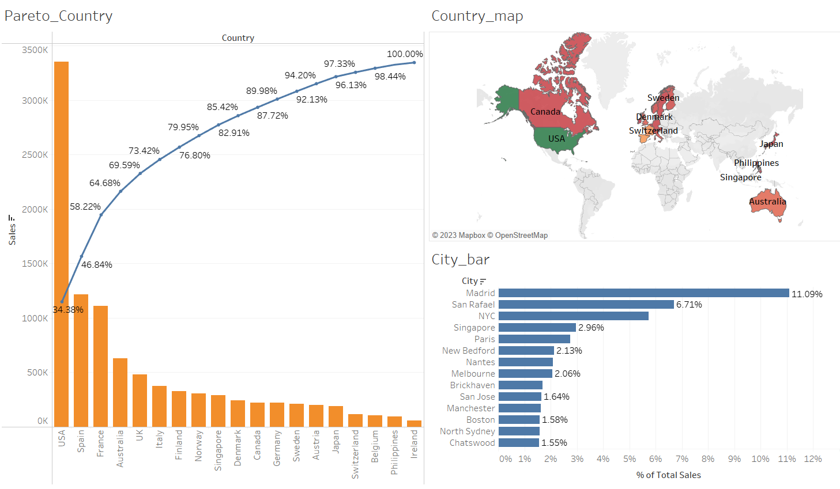
Sales across categories
Understanding the Data
Observations
USA, Spain, France, Australia & UK contribute about 70% sales market.
Cities like Madrid, San Rafael, NYC, Paris, New Bedford are highest in market sales.

Slide 14
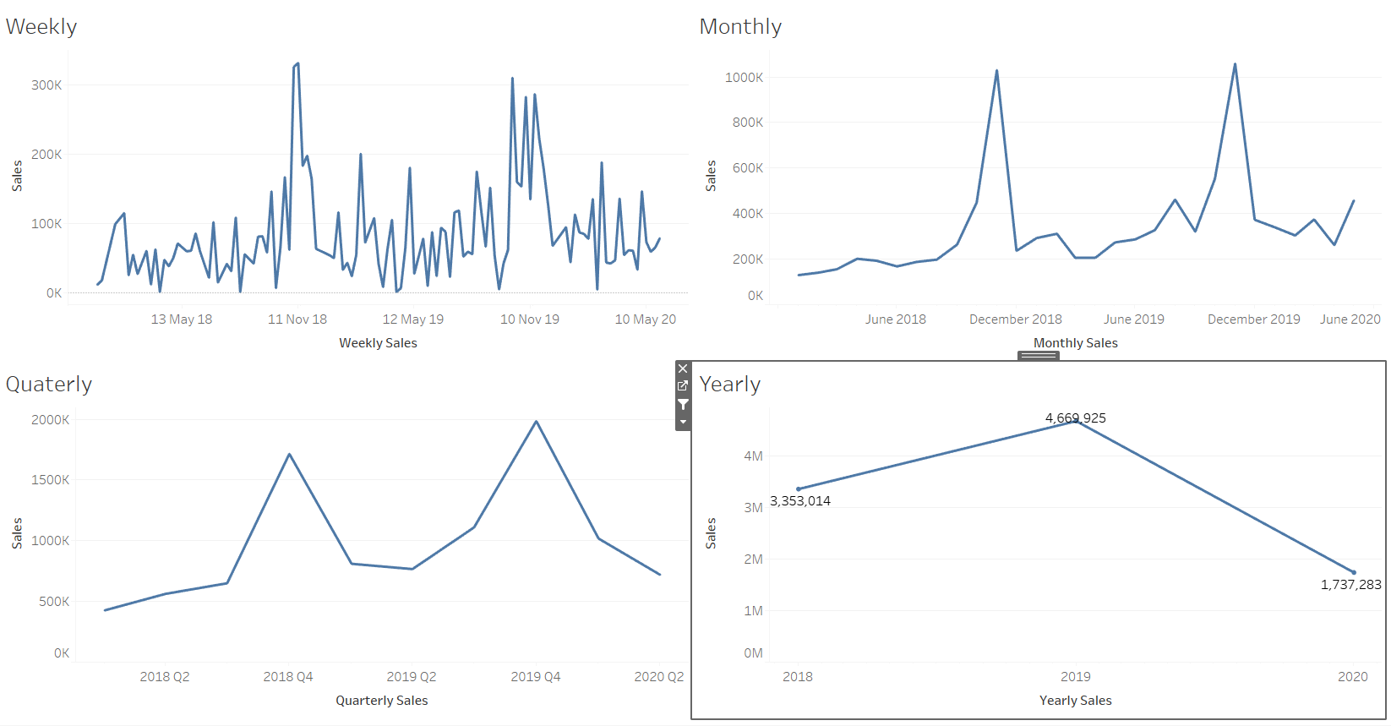
Weekly, Monthly, Quarterly
Yearly Sales Trend
Understanding the Data
Observations
Yearly sales have declined.
Monthly and Quarterly sales have Trend & Seasonality.
Nice trend observed in weekly sales.

Slide 15
Summary of Inferences
Classic Cars occupy 40% of total sales.
Vintage cars about 18% of total sales.
Motorcycles, Trucks/Bus & Planes around 10%.
Medium size grabs 60% of market sales.
Shipped goods contribute most of the sales more than 90%.

Slide 16
Summary of Inferences
Shipped, Medium size Classic cars, Vintage cars, motorcycles & Trucks/Bus grab 47% of markets sales.
Shipped, Large size, classic cars about 7.5% of market sales.
USA, Spain, France, Australia & UK contribute about 70% sales market.
Cities like Madrid, San Rafael, NYC, Paris, New Bedford are highest in market sales.

Slide 17
Summary of Inferences
Cities like Madrid, San Rafael, NYC, Paris, New Bedford are highest in market sales.
Yearly sales have declined.
Monthly and Quarterly sales have Trend & Seasonality.
Nice trend observed in weekly sales.

Slide 18
What is RFM ?
RFM stands for Recency, Frequency & Monetary.
RECENCY:
How recently the customer interacted with website/transaction etc.
FREQUENCY:
How frequently the user interacted.
MONETARY:
How much in total the user had spend in terms of money.

Slide 19
What Parameters used?
RECENCY
Recency is calculated using number days from the recent transaction of a customer
FREQUENCY
Frequency is calculated Number of time the customer visited in his entire lifetime.
MONETARY
Monetary is calculated as total amount of money spent by the customer in his entire lifetime.

Slide 20
Assumptions ?
To segment customers we need to divide the distribution of RFM into ‘n’ number of segments. In this case we are dividing into 4 segments.
It means distribution is captured between these quantiles 0,0.25,0.5,0.75,1 .
The captured distribution is rated between 1 to 4 from low to high for Frequency & Monetary.
The captured distribution is rated between 1 to 4 from high to low for Recency, because lower the recency the better.

Slide 21
Output Table
CUSTOMERNAME | RECENCY__ | FREQUENCY__ | MONETARY__ | RFM_Combined
AV Stores, Co. | 2 | 4 | 4 | 244
Alpha Cognac | 1 | 1 | 1 | 111
Amica Models & Co. | 3 | 2 | 3 | 323
Anna's Decorations, Ltd | 4 | 4 | 4 | 444
Atelier graphique | 3 | 1 | 1 | 311
Australian Collectables, Ltd | 1 | 2 | 1 | 121
Australian Collectors, Co. | 4 | 4 | 4 | 444
Australian Gift Network, Co | 4 | 1 | 1 | 411
Auto Assoc. & Cie. | 3 | 1 | 1 | 311
Auto Canal Petit | 4 | 3 | 3 | 433
Auto-Moto Classics Inc. | 1 | 1 | 1 | 111
Baane Mini Imports | 4 | 3 | 3 | 433
Bavarian Collectables Imports, Co. | 1 | 1 | 1 | 111
Blauer See Auto, Co. | 1 | 2 | 2 | 122
Boards & Toys Co. | 3 | 1 | 1 | 311
CAF Imports | 2 | 1 | 1 | 211
Cambridge Collectables Co. | 2 | 1 | 1 | 211
Canadian Gift Exchange Network | 3 | 2 | 2 | 322
Classic Gift Ideas, Inc | 3 | 2 | 1 | 321
Classic Legends Inc. | 3 | 1 | 2 | 312
Clover Collections, Co. | 1 | 1 | 1 | 111
Collectable Mini Designs Co. | 2 | 2 | 2 | 222
Collectables For Less Inc. | 4 | 2 | 2 | 422
Corrida Auto Replicas, Ltd | 3 | 3 | 4 | 334
Cruz & Sons Co. | 1 | 2 | 3 | 123
Daedalus Designs Imports | 2 | 1 | 1 | 211
Danish Wholesale Imports | 2 | 4 | 4 | 244
Diecast Classics Inc. | 4 | 3 | 4 | 434
Diecast Collectables | 1 | 1 | 2 | 112
Double Decker Gift Stores, Ltd | 1 | 1 | 1 | 111
Dragon Souveniers, Ltd. | 1 | 4 | 4 | 144
Enaco Distributors | 1 | 2 | 2 | 122

Slide 22
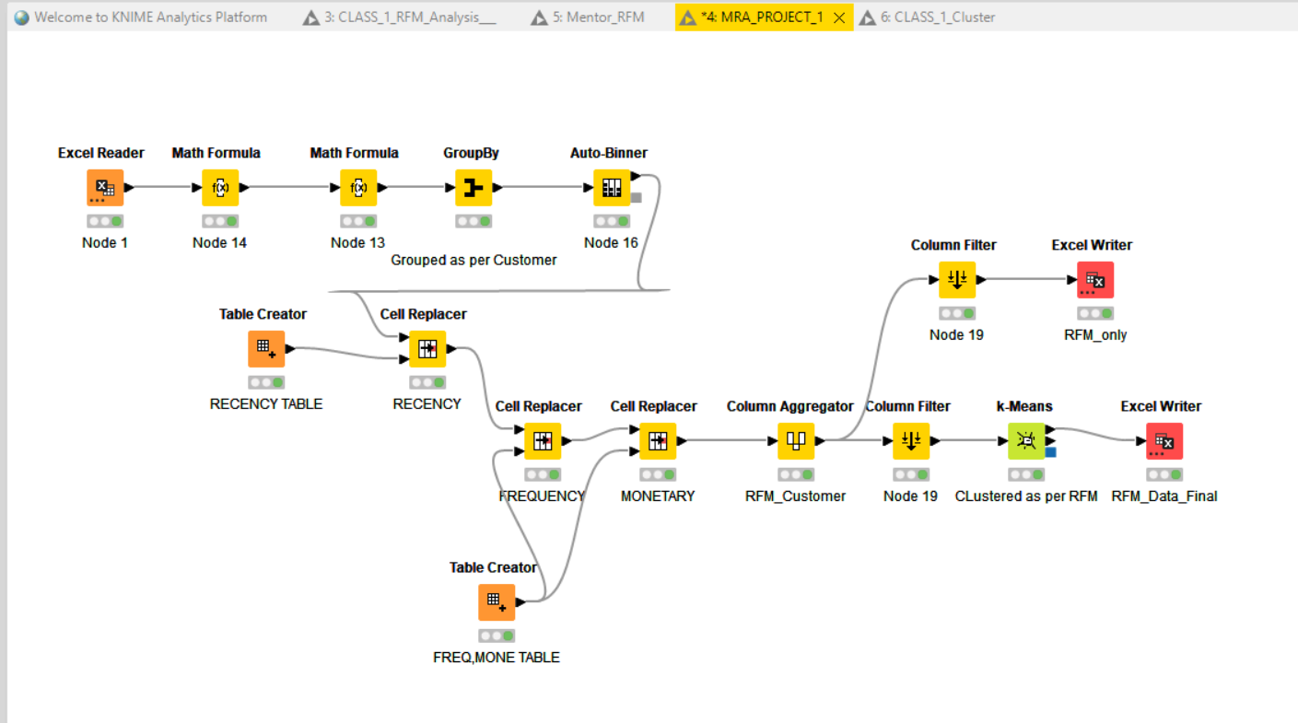
KNIME Work FLow

Slide 23
RFM Analysis
Top 5 Customers
Top 5 customers who score all 444’s .
CUSTOMERNAME | RFM_Combined | RFM_Score | Cluster
Euro Shopping Channel | 444 | 12 | cluster_0
Mini Gifts Distributors Ltd. | 444 | 12 | cluster_0
Australian Collectors, Co. | 444 | 12 | cluster_1
La Rochelle Gifts | 444 | 12 | cluster_1
Land of Toys Inc. | 444 | 12 | cluster_1

Slide 24
RFM Analysis
Lost 5 Customers
Inactive/Lost 5 customers who score all 111’s .
CUSTOMERNAME | RFM_Combined | RFM_Score | Cluster
Alpha Cognac | 111 | 3 | cluster_3
Auto-Moto Classics Inc. | 111 | 3 | cluster_3
Bavarian Collectables Imports, Co. | 111 | 3 | cluster_3
Clover Collections, Co. | 111 | 3 | cluster_3
Double Decker Gift Stores, Ltd | 111 | 3 | cluster_3

Slide 25
RFM Analysis
Loyal 5 Customers
Loyal 5 customers who score high, moderate(3,4) in Recency & Frequency but average Monetary(2,3).
CUSTOMERNAME | RFM_Combined | RFM_Score | Cluster
Diecast Classics Inc. | 434 | 11 | cluster_2
Reims Collectables | 344 | 11 | cluster_1
Scandinavian Gift Ideas | 344 | 11 | cluster_1
UK Collectables, Ltd. | 433 | 10 | cluster_2
Baane Mini Imports | 433 | 10 | cluster_2

Slide 26
RFM Analysis
Verge of churning 5 Customers
About to Churn 5 customers who score low(2,3) Recency but high, moderate(3,4) in Monetary & Frequency
CUSTOMERNAME | RFM_Combined | RFM_Score | Cluster
Reims Collectables | 344 | 11 | cluster_1
Scandinavian Gift Ideas | 344 | 11 | cluster_1
Corrida Auto Replicas, Ltd | 334 | 10 | cluster_2
Muscle Machine Inc | 244 | 10 | cluster_1
AV Stores, Co. | 244 | 10 | cluster_1

Slide 27
Thank You

